Slide 1

BLACK FRIDAY SALES PREDICTION
P
R
E
D
I
C
T
I
O
N
SALES ANALYSIS
NAME: RADHARAPU REVANTH
ROLL NO: 240352418
CSE AIML 15

Slide 2
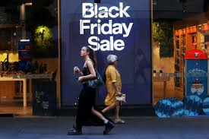
PROBLEM STATEMENT:
Predict customer purchase amounts during Black Friday sales using historical transaction and demographic data.
The goal is to build a machine learning model that identifies key factors influencing spending behavior.
This helps retailers optimize pricing, inventory, and targeted marketing strategies.
The project also aims to improve sales forecasting accuracy for large-scale retail events.

Slide 3
Explanation of the Project:
Uses historical retail data (customer demographics, product categories, purchase history).
Incorporates variables like age, gender, occupation, and city category.
Applies machine learning algorithms for predicting purchase amounts.
Includes data preprocessing, feature engineering, and model evaluation.
Visualizes trends and patterns in customer spending behavior during Black Friday

Slide 4

Explanation of the Project:
Collected weekly sales data
Loaded data into Python using Pandas
Cleaned and organized the dataset
Calculated weekly increment using formula:
Increment = Current Week Sales − Previous Week Sales
Applied prediction technique to forecast future sales
Visualized results using graphs

Slide 5
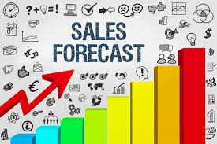
Description of the Model/Algorithm Used:
This project uses supervised machine learning algorithms to predict customer purchase amounts based on historical data from Black Friday sales.
A commonly used model is Linear Regression, which predicts a continuous target variable (purchase amount) by finding relationships between independent variables such as age, gender, occupation, and city category.

Slide 6

TOOLS & TECHNOLOGIES USED
Python – Programming language used for prediction
Pandas – For data loading and data manipulation
NumPy – For numerical calculations
Matplotlib – For plotting graphs
Jupyter Notebook / VS Code – Development environment

Slide 7
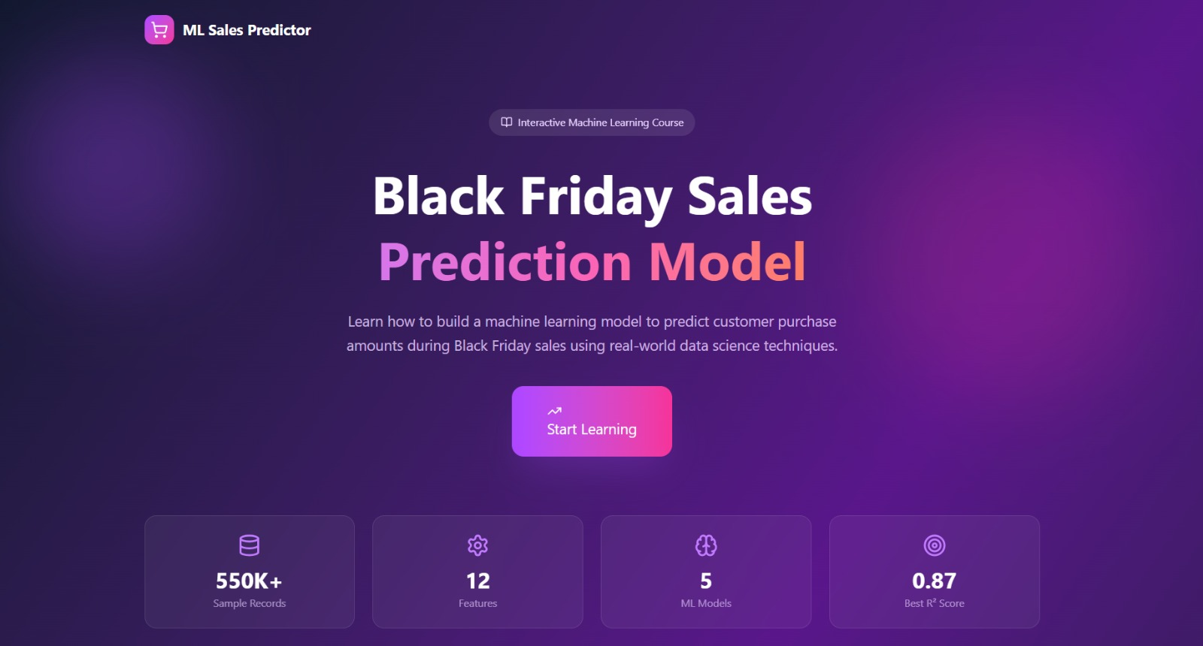
Accuracy / Performance Metrics of the Model:

Slide 8
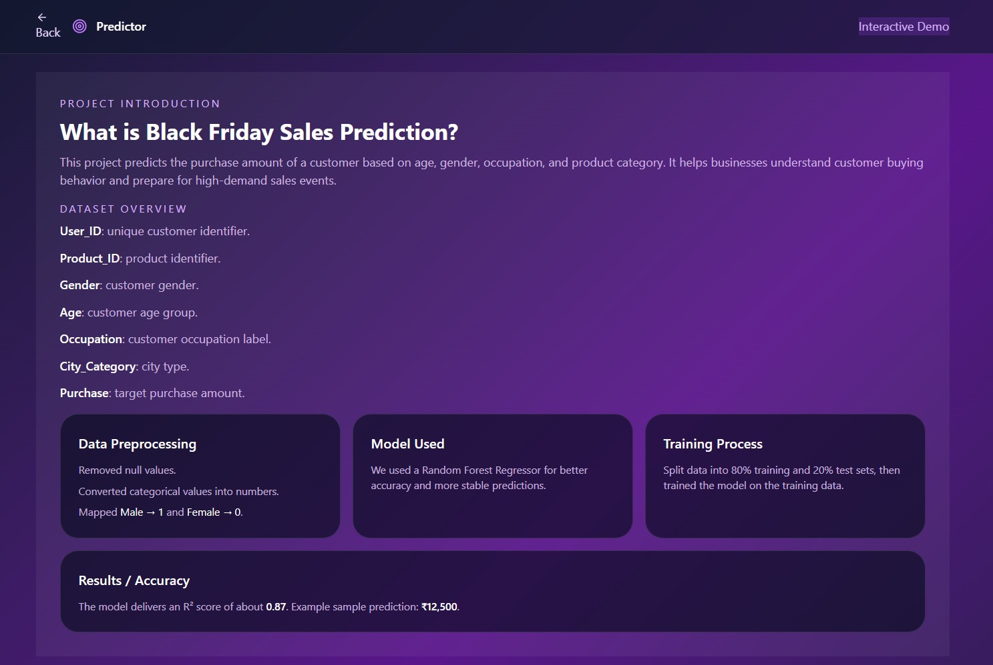
Accuracy / Performance Metrics of the Model:

Slide 9
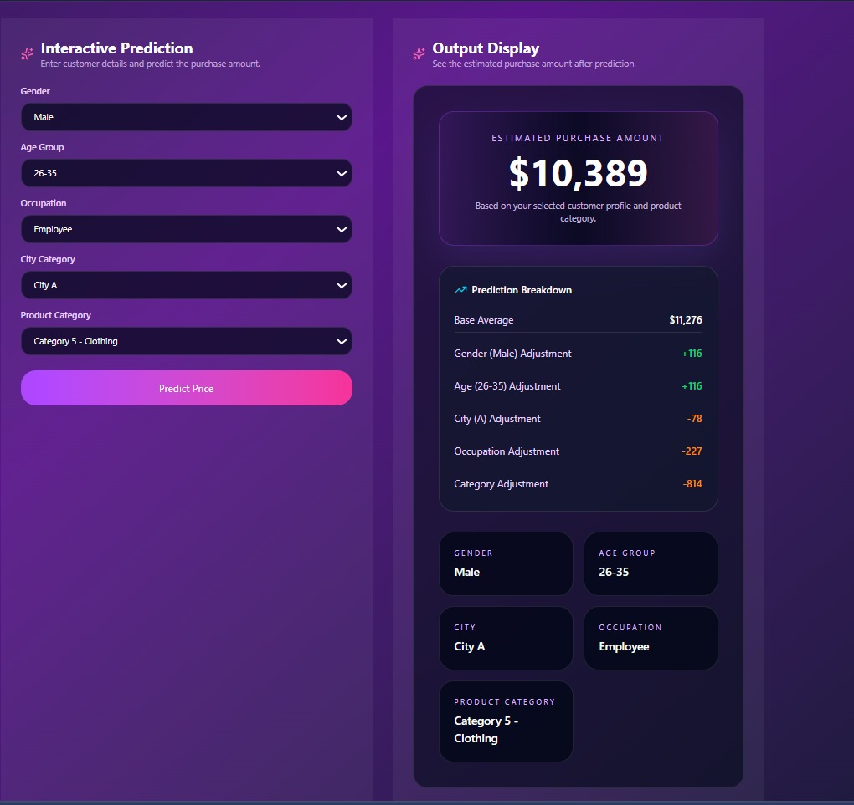
Accuracy / Performance Metrics of the Model :

Slide 10
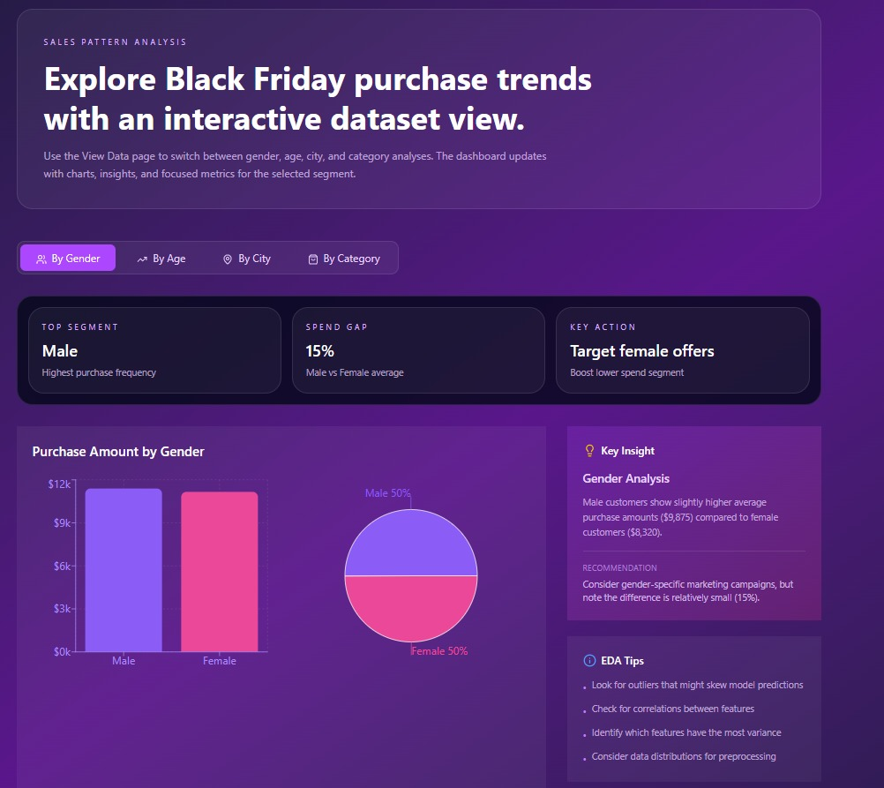
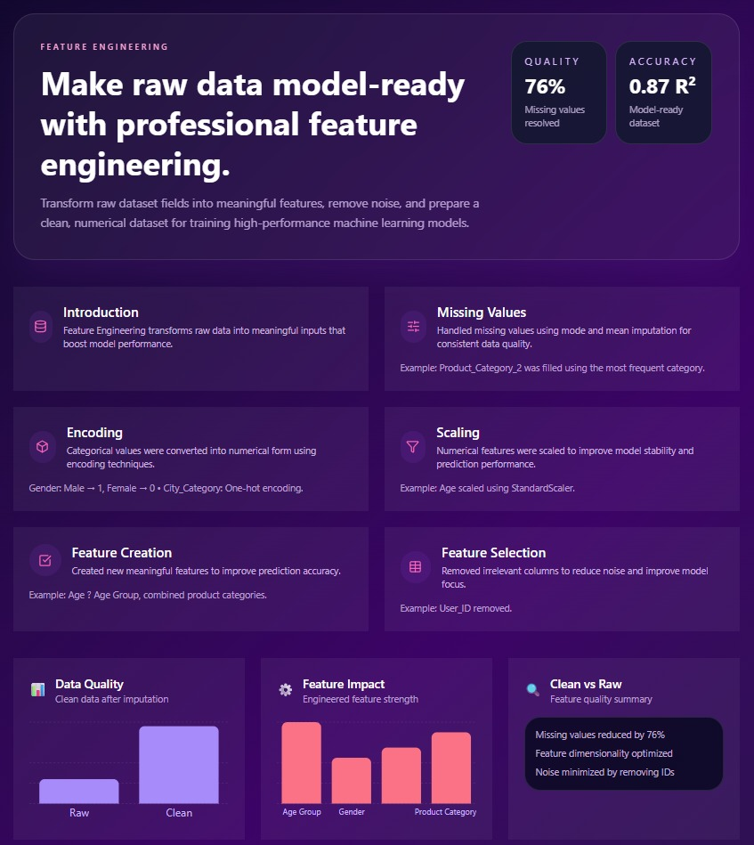
Figures/Plots Showing Results :

Slide 11
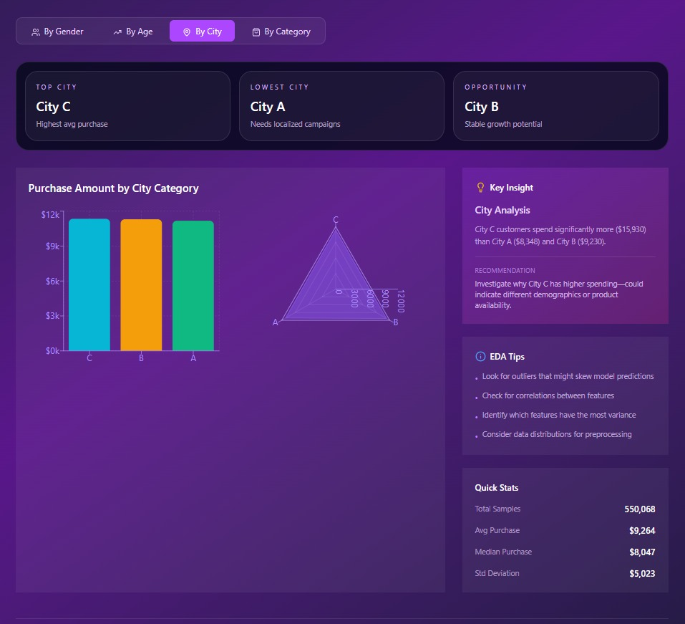
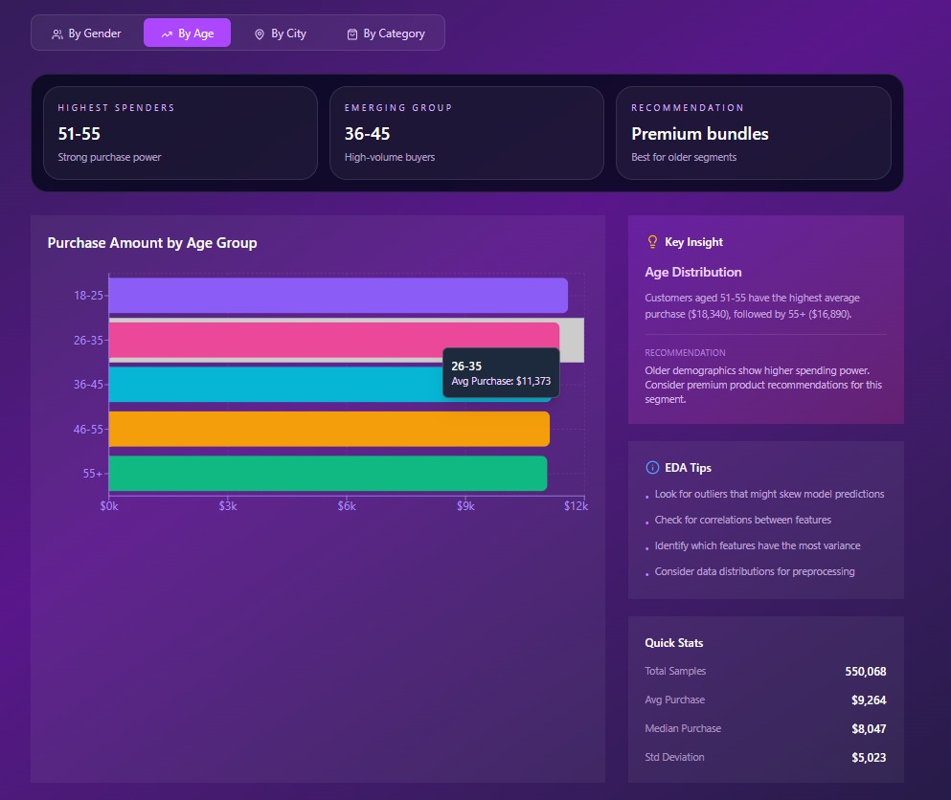
Figures/Plots Showing Results :

Slide 12
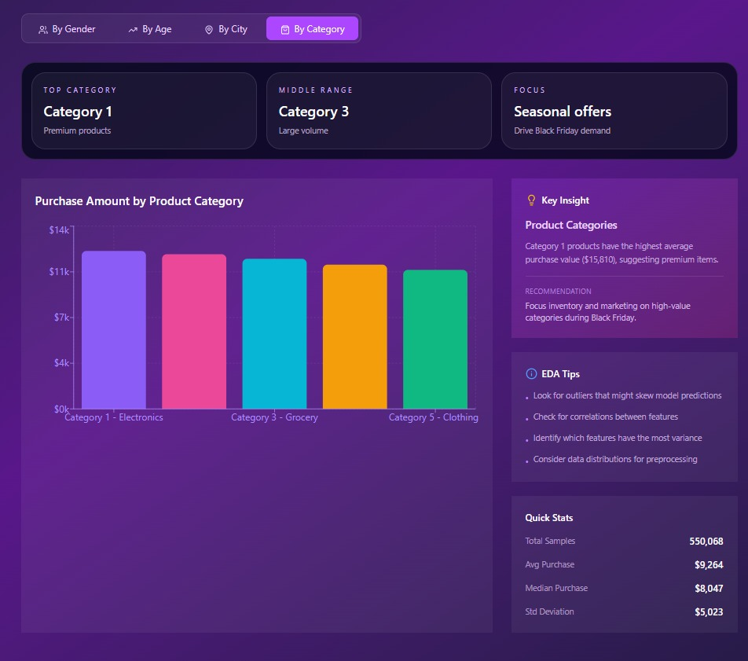
Figures/Plots Showing Results :

Slide 13
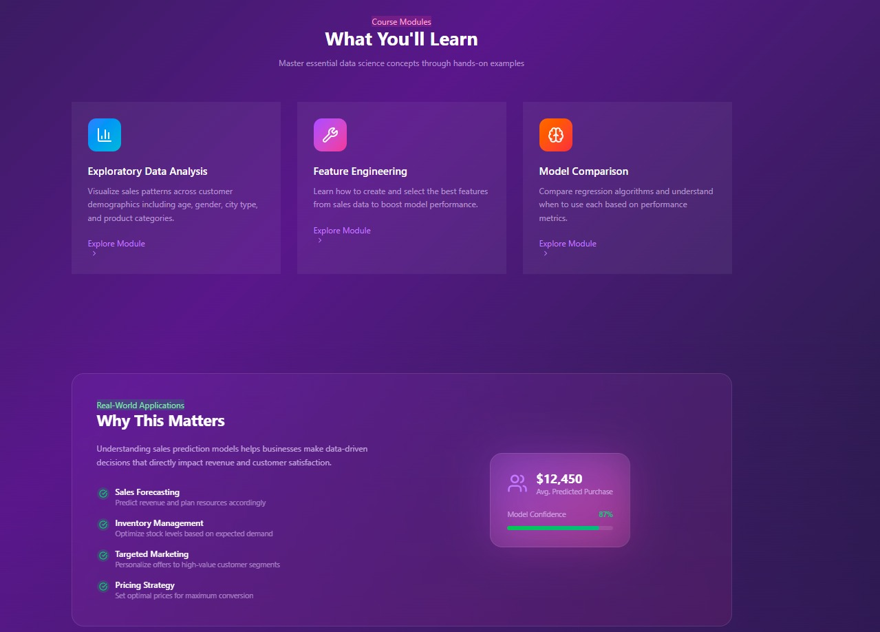
Figures/Plots Showing Results :

Slide 14

Outcome & Conclusion of the Project:
This project uses machine learning to predict customer purchase amounts during Black Friday sales.
It analyzes factors like demographics and product categories to understand buying behavior.
The model helps businesses make better decisions in marketing and inventory management.
Overall, it improves sales forecasting and efficiency.

